Slide 1
Rally Health Eligibility Canonical Update
Team Mackers
Notes:
Tony

Slide 2

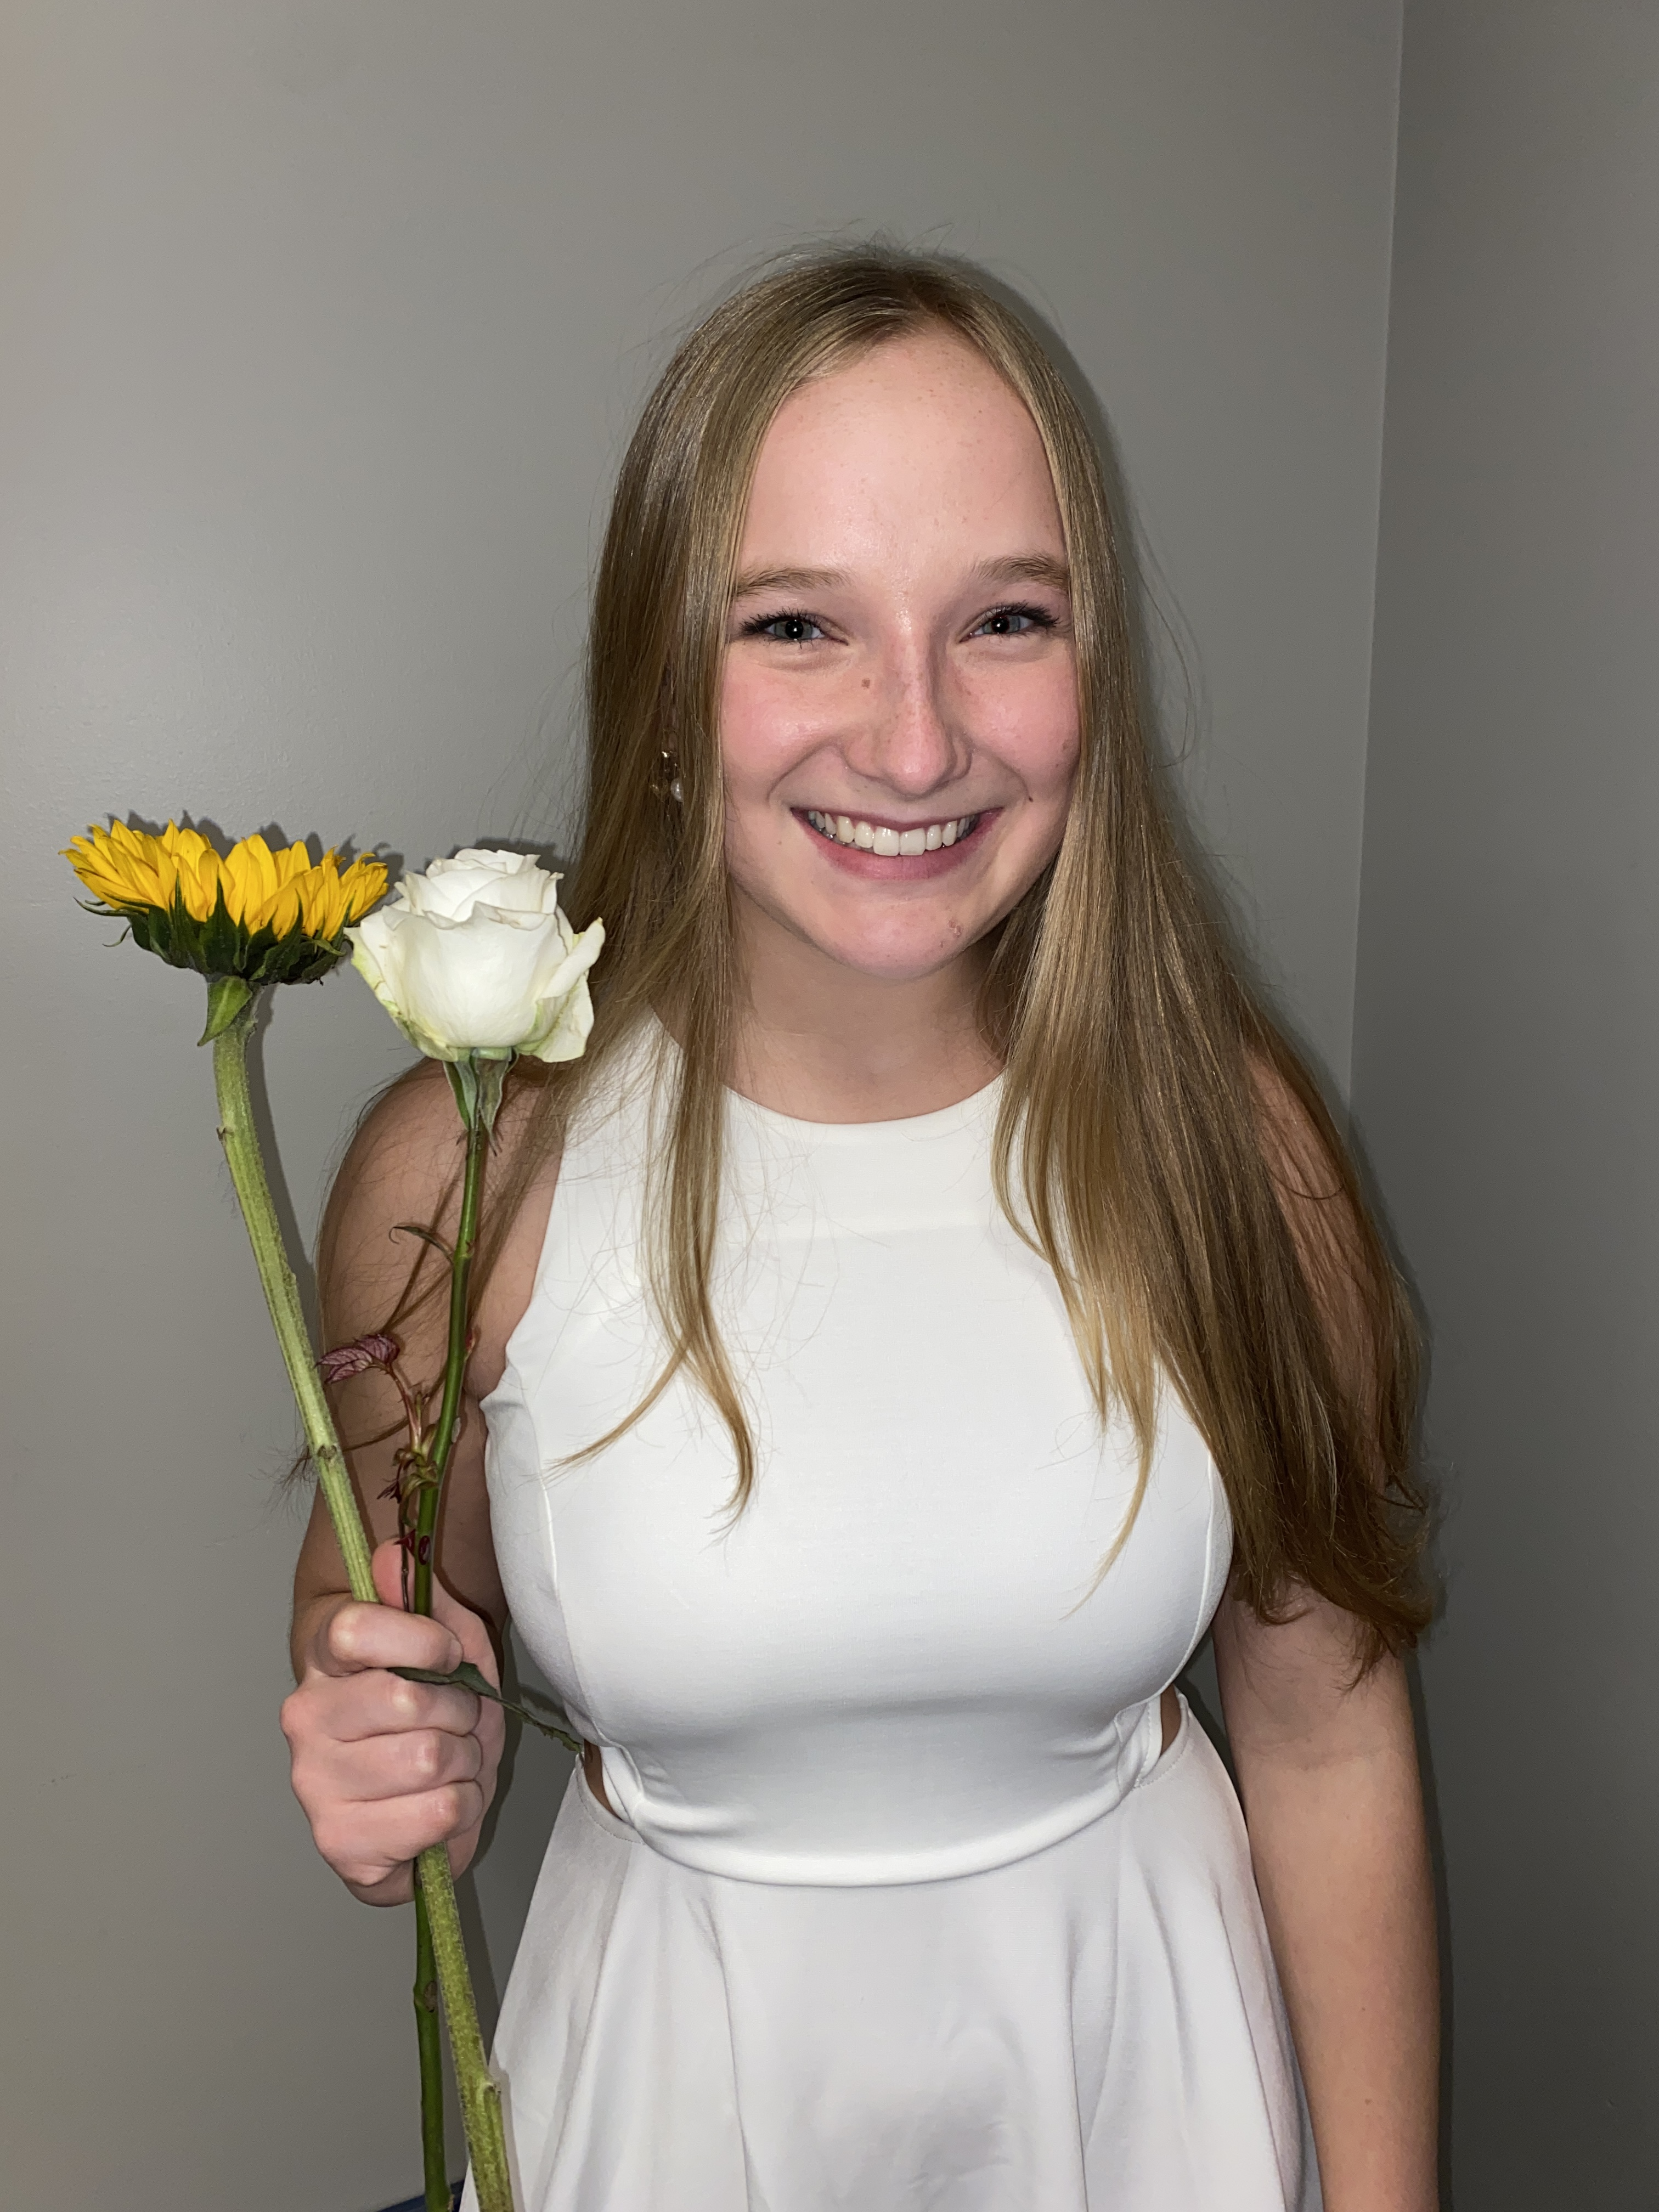


Introduction
Tony Cai
University of Minnesota
Kristen Hawken
Iowa State
Naren Nandyal
University of Minnesota
Mason Schmidt
Pensacola Christian College
Notes:
Tony
Standard Assets Engineering Operations
"We partner with Optum data producers and consumers, along with Enterprise Data Architects, to design and implement standard data stores that make the most critical Optum data available to all parts of the business in a common, well understood form.”

Slide 3




Problem Statement
Background:
V2: the old way of constructing canonical streams
Costly
Risky
V3: current way of constructing canonical streams
Simplify transition
$250-300k Savings/Month
V2
V3
Rally Health
Notes:
Tony
Rally Health provides reward programs for customers of uhg
Currently check eligibilities through v2 stream
bad, because of high risk and high cost from limited knowledge, support, and outdated technologies
our project is updating Rally Health from V2 canonical streams to V3, therefore reducing cost and risk for us without Rally Health noticing a difference.
Rally will Consume same message, feel no effects. Not impacting consumer

Slide 4



How will we achieve this goal?
Using two different types of testing
Utilizing EBaaS to map the V3 canonical to the Rally canonical
Using testing to make sure the mapping is done correctly
Unit testing – for specific mapped values
Using the EBaaS test harness – for testing all the mapped values
Notes:
Tony
Use EBaaS test harness and mapper to map v3 canonical schemas to Rally schema
Like any software, it requires testing tests that will tell us if our mapping is incorrect.
Unit testing to incrementally work through mapper logic, test harness to bring everything together

Slide 5
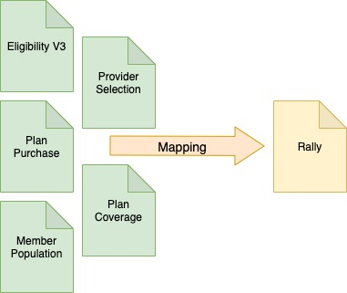
Completed Mapper
Pulls from multiple canonicals
Specific fields from each are mapped to the Rally canonical
Notes:
Tony
From our last presentation, our mapper has been finished.
Pulls most fields from the eligibility v3 canonical, but also takes other fields from separate canonicals
other fields have to pull from different canonicals such as, plan purchases, member population etc
all necessary fields get mapped to rally canonical format
While Finished, we must create more tests in order to capture and check edge cases
Naren will go in depth into the specifics of how we unit tested this mapepr

Slide 6
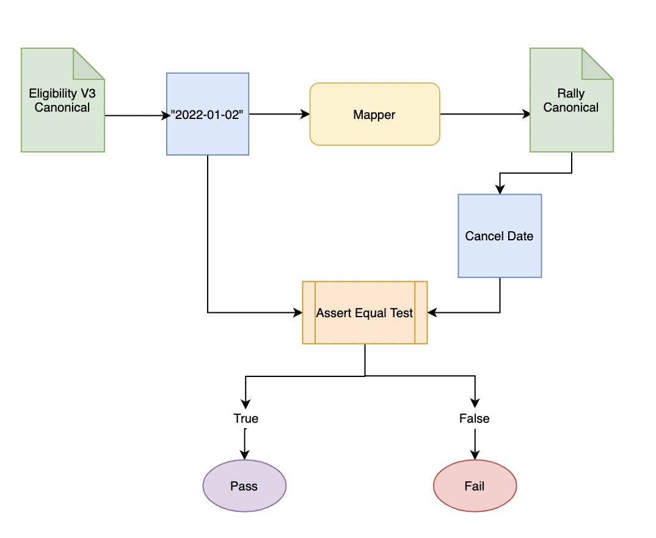
Specific unit test example
Notes:
Naren
In order to confirm that our mapping was done correctly, we created numerous unit tests for each of the fields that we mapped.
To give a sample of how a unit test work, this diagram shows the testing of the “cancelDate” field
-we first found the date that was assigned to the cancelDate field in our eligibility input canonical.
-Then we mapped this whole input canonical to the Rally canonical.
-Then, in our unit testing, we used an Assert Equal test to compare the cancel Date value we had noted down from our input with the cancelDate field in the Rally Health Canonical.
-If these fields matched, the assert equal test would return true and the test passed.

Slide 7
Completed Unit Testing Video
Notes:
Naren
-We now have a demo of our unit tests for all our mapped values
-You can see all the fields have their own assert equals with the specific value from the input canonical compared to the corresponding fields in the rally health canonical.
-The output shows all the fields and that they pass
-One thing to keep in mind: there could be edge cases that we did not account for
-This is NOT the code for the mapping, which we also did, but just the testing for the mapping
Next, Mason will dive deeper into our second form of testing

Slide 8
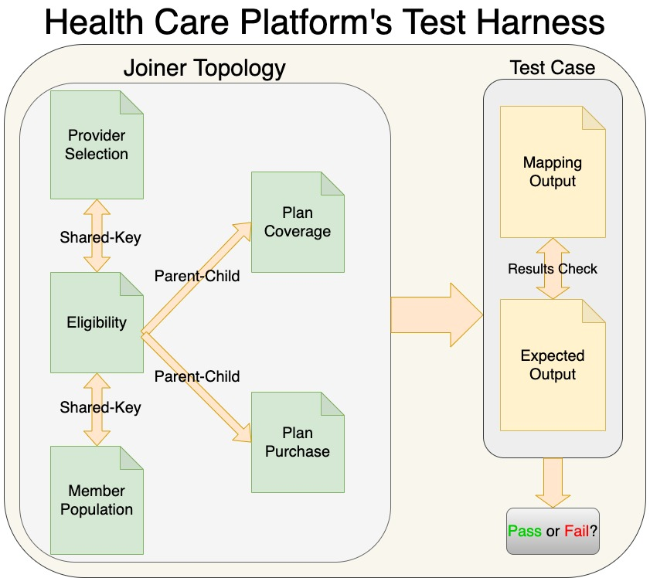
Notes:
Mason
Here is an overview of what we did with the test harness.
First, we set up our joiner topology for all of our input canonicals.
The way they are joined together is by their keys.
Each canonical has at least one key that we can use.
So inside the joiner topology you can see provider selection, eligibility, and member population all had the same key.
For plan coverage and plan purchase, eligibility had there keys, but it was in its value section so we used a parent-child step.
Next we take all of the joined canonicals and map them.
We compare what was mapped with what we are expecting.
If there are no differences, the test passes. If there is a difference, then it fails.
In the next slide I have a video of a test harness test passing.

Slide 9
Completed Test Harness Video
Notes:
Mason
Here we have the joiner topology that we talked about in the last slide. We are currently using 4 different topology steps. Then you can see that we ran the test from our configuration folder and got a pass. So that means that all of the mapping that was done was done correctly according to the expected output that we have in the test.

Slide 10
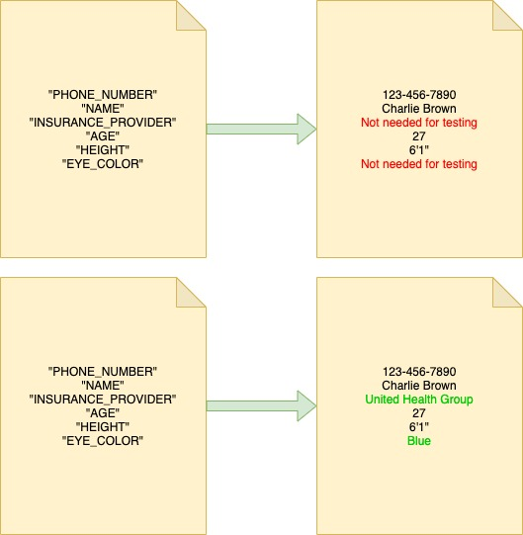
Filling in the Input Canonicals
Notes:
Mason
When we were working on testing, we only added fields in the canonicals that we needed to map. However, we went back and decided to add in all the fields. This will make it easier for people in the future who want to consume from these canonicals. Because then they would already have test data to use, and they wouldn’t have to fill it in themselves.

Slide 11
Challenges
Mapping
Test Harness
Arrays vs non arrays
Joining keys in an array
Optimization
Input Canonicals
Eligibility V3’s length
Notes:
Kristen
Differences in types between v2 and v3, specifically non array to array
Resolved this issue by looking closely at rally eligibility canonical and what they need
Also resolved by fact that these fields have unique identifiers so part of their logic will be handled outside of the mapper
Another challenge was when filling all of the input canonicals, the eligibility v3 schema is thousands of lines long, with the resulting input canonical being much longer
We resolved this by finding a way to split up the work, and then eventually splitting the end product up in 2 thousand line chunks for each of us to double check
Then working with the test harness, we had trouble joining keys in an array
Because there could be multiple of the same keys in a list, we had to use a fan-out step to get each individual key
We also did optimization topreventing replication of data, will continue to work on optimizing the joiner in the future as it takes longer than we want for it to run, better way to access the arrays

Slide 12
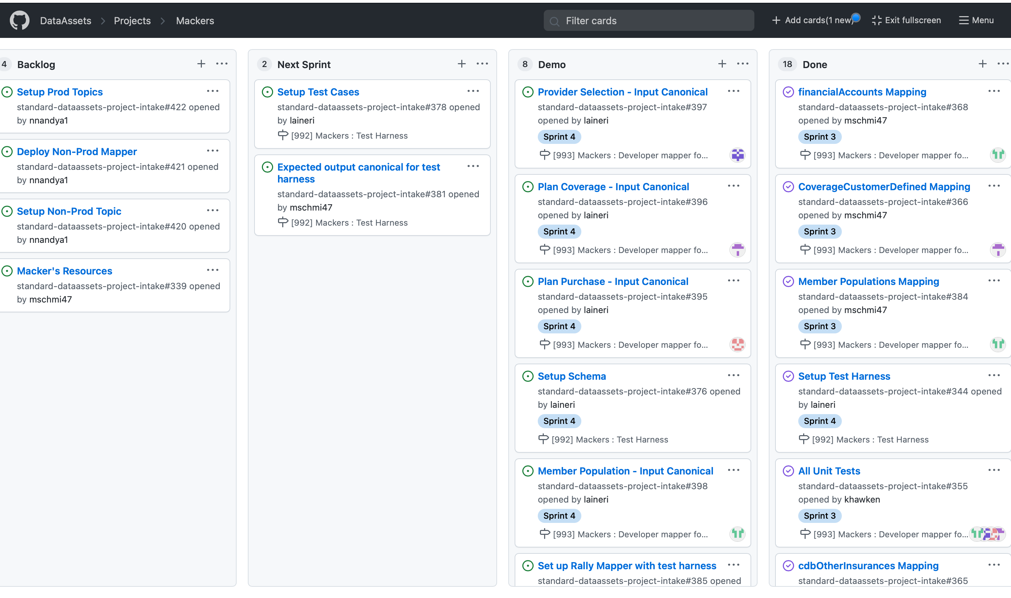
Notes:
Kristen
.
Here is our Kanban board where you can see an overview of our project. Our done column includes all the mapping logic and unit tests, and setting up test harness.
In our demo column, we have the rest of the tasks we’ve completed, including filling in the input canonicals, setting up the joiner, and connecting our mapper to the test harness
You can see in our next sprint we have creating specific tests for test harness and creating corresponding expected output canonicals to do so.
On backlog we have transitioning back to the business, which includes setting up a non prod topic, setting up prod topics and deploying the non prod mapper.
We may not get to prod deployment, but that would be something we would set up for our team to takeover.

Slide 13
Conclusion
Our Goal
What We’ve Done
Next Steps
Final Product
Notes:
Kristen
-Create a seamless transition from V2 to V3 for Rally Health
-Completed mapper, set up test harness, and filled in complete canonicals
-Creating tests for the test harness and working towards deployment
-When rally health is on the V3, they will have a more reliable data stream to calculate their eligibilities and Optum will be saving hundreds of thousands of dollars

